Slide 1
सफर वसुंधरेची
Here is where our presentation begins

Slide 2
TABLE OF CONTENTS
01
04
About the Project
Sneak Peek
02
05
Major Requirements
Project Stages
03
06
project Goals
Our Team

Slide 3
ABOUT THE PROJECT
We are working on this project by making a Desktop application where the Traveler who want to travel with friends but his friends are not coming that time he can book the trip with us.

Slide 4

Why we choose this project

Slide 5

No one with coming with me!! I am alone!!!!!!!

Slide 6
WHAT WE ARE WORKING ON
SECURE
ACCESSIBLE
Less-Price
Our Software is fully secured and users information is safe with us.
Our Software is friendly and easy to use.
We provide packages with low price

Slide 7
STEPS FOR CONNECTING DATABASE
Step 1: Filter your HTML form requirements for your contact us web page
Step 2: Create a database and a table in MySQL
Step 3: Create HTML form for connecting to database
Step 4: Create a PHP page to save data from HTML form to your MySQL database
Step 5: All done!

Slide 8
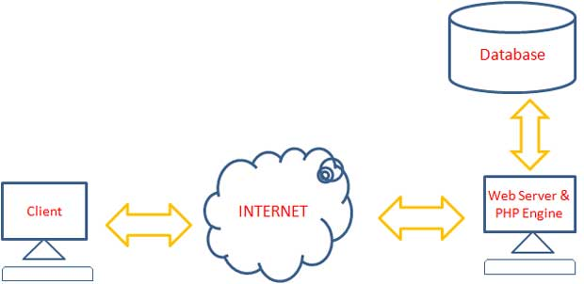
ARCHITECTURE OF A SYSTEM

Slide 9
—Saint Augustine.
““The world is a book and those who do not travel read only one page.”

Slide 10
DISADVANTAGES :
It needs internet access
You might face technical issues
Not every online booking software might be the right one

Slide 11
FUTURE
CAR BOOKIING
MORE CLASSIFIED DATA
ADAPTABILITY

Slide 12
MAJOR REQUIREMENTS
IMAGES
USER EXPERIENCE
INFORMATION
We Collected various images , graphs and icons from different sources.
Due to this project we have gained experience in Java, Java swing and
MySQL
Several information about all the different colleges, courses and cutoffs etc. was required.

Slide 13
HARDWARE REQUIREMENTS
MICROSOFT
CONFIGURATION
Microsoft windows machine
RAM: 8GB
HARD DISK: 512 GB

Slide 14
OUR GOALS
EXPANSION
POSITIONING
USABILITY
We want to expand our project by adding more Places , Packages and a lot more choices for Travel.
After a lot of hardwork, dedication and modification our team will surely make at the top as the best application for Traveler
We want every Traveler to be able to use our Application easily and affordably

Slide 15
PROJECT STAGES
STEP 2
STEP 1
STEP 3
We have prepared a very basic plan and design of our Software
Our team has gathered every information required for the project
Implementing the project

Slide 16
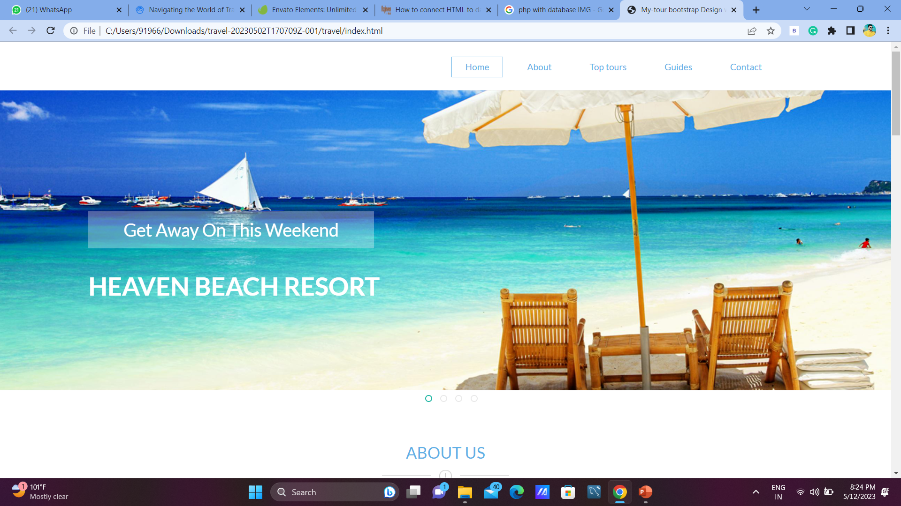
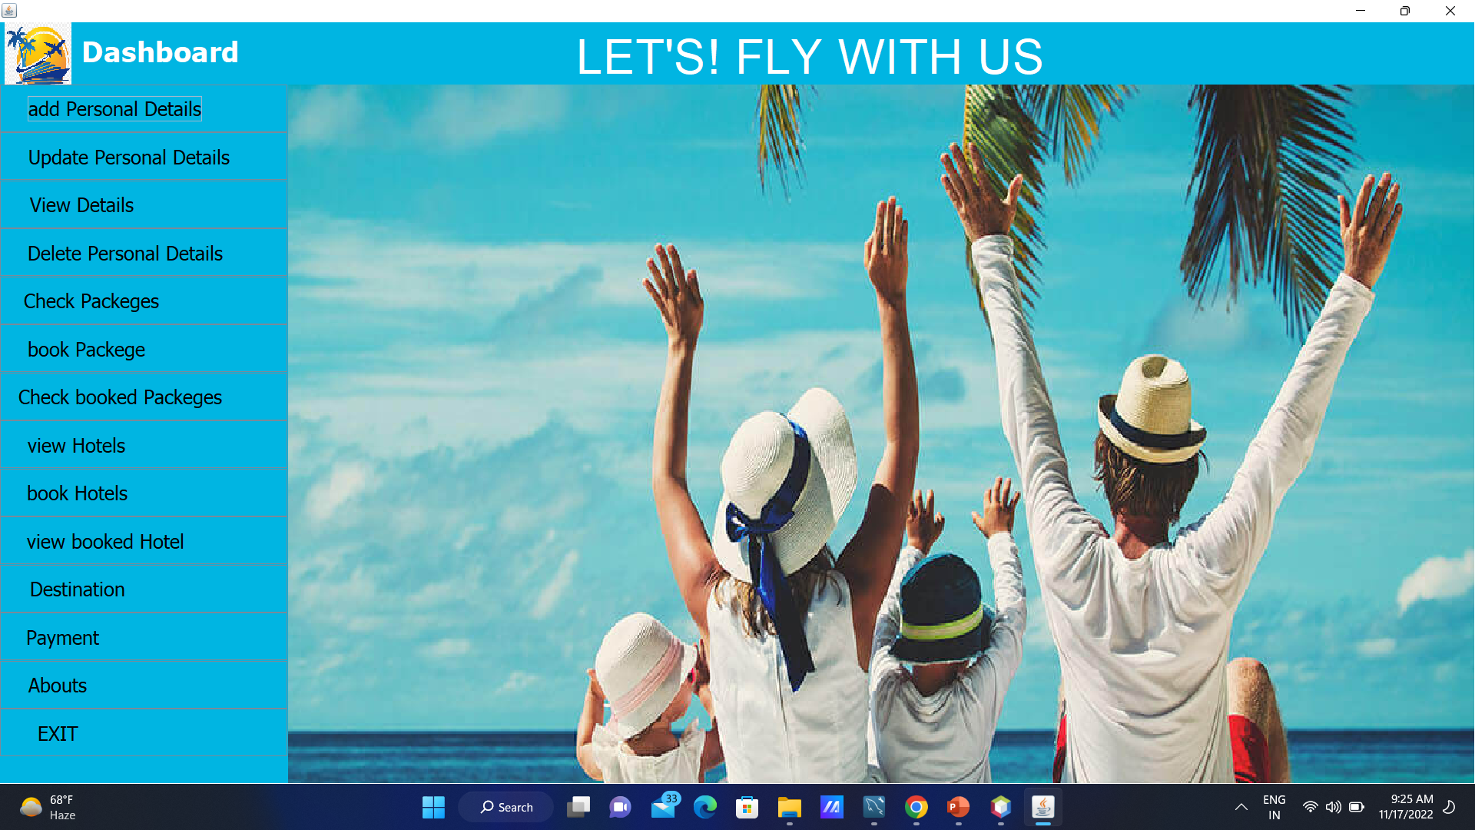
DESIGN

Slide 17
OUR TIMELINE
WEEK 1
WEEK 3
BETA
RELEASE
FINAL
VERSION
WEEK 2
WEEK 4
Gathering Information
Design
Learning skills
Implement

Slide 18



OUR PARTNERS
NIKITA
GOOGLE
RAMESHWAR
Front end Implementation
Java programmer
Database connector
Database Creator
Backend Developer
Google is our most of the important source for collecting information

Slide 19
THANKS!

Slide 20
CREDITS
This is where you give credit to the ones who are part of this project.
Guidence by prof. P. N. Kate - Deshmukh
Presentation and page Design by Nikita
Implimentation of web-page by Rameshwar

